Slide 1
R for statistic Graphs with ggplot2!
George Savva (QIB)
Jan 2023

Slide 2
Statistical modelling and plotting
Data wrangling
(cleaning, coding, reshaping)
Visualisation
Modelling
Reporting
Where does plotting fit into this workflow, and what is it for at each stage?

Slide 3
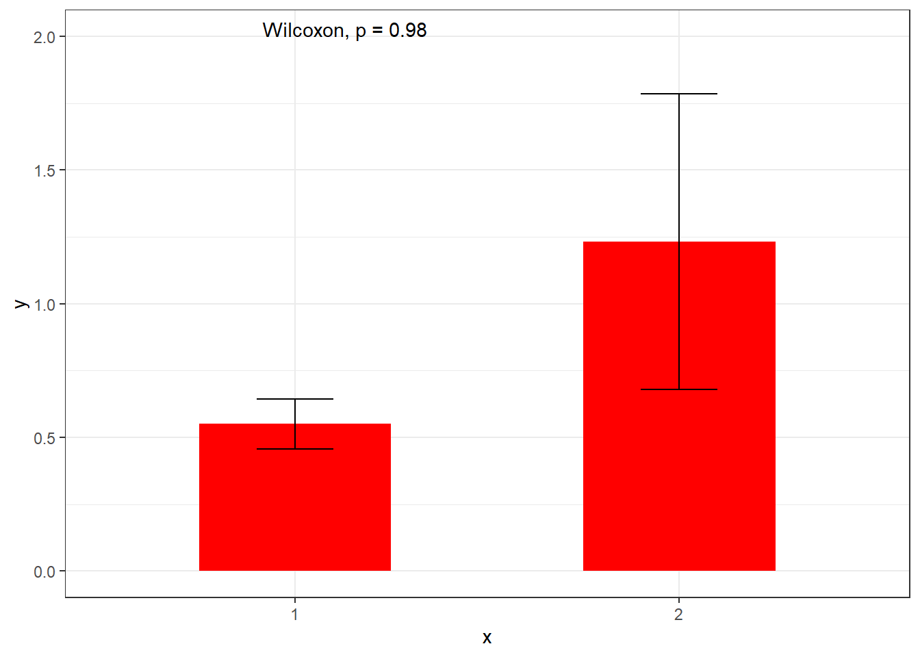
The plot is not the inference
A typical graph..
What is it trying to do?
Visualisation?
Modelling?
Reporting?
How is it helpful / unhelpful?
What might we do differently?

Slide 4
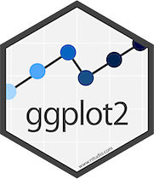
ggplot2 vs R ‘base’ graphics
Base graphics
Simple to use
Complicated to adjust
Difficult to get right
ggplot2 (since 2005)
By Hadley Wickham
Slightly more complicated to set up
Very powerful!
Now at version 3
Suggestions: Learn ggplot2!
Be aware of the ‘base’ plotting options plot() etc.
Seek out the many ggplot2 extensions relevant to your field

Slide 5
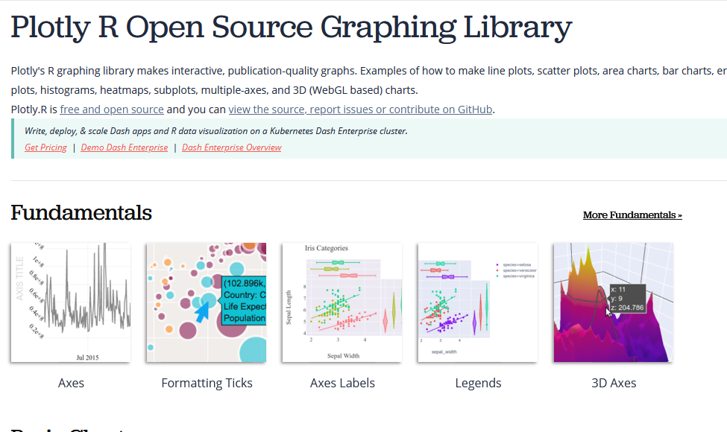
Other R packages for graphics
Plotly (Interactive graphics for the web). www.plotly.com/r/

Slide 6
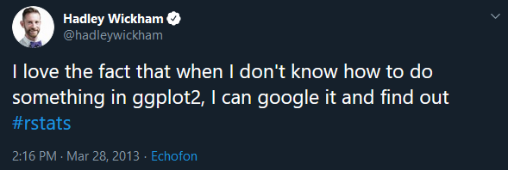
How to learn ggplot2
Thomas Lin Pederson’s videos “Plotting anything with ggplot2” https://www.youtube.com/watch?v=h29g21z0a68
https://www.r-graph-gallery.com/
https://ggplot2-book.org/
https://www.cedricscherer.com/2019/08/05/a-ggplot2-tutorial-for-beautiful-plotting-in-r/
https://github.com/rstudio/cheatsheets/blob/master/data-visualization-2.1.pdf
#30DayChartChallenge (data viz)
#tidytuesday, #Rtistry (generative art with R)
Learn how ggplot2 works.
If you’re stuck, look at a book, official documentation or a vignette
Think about why it does what it does

Slide 7
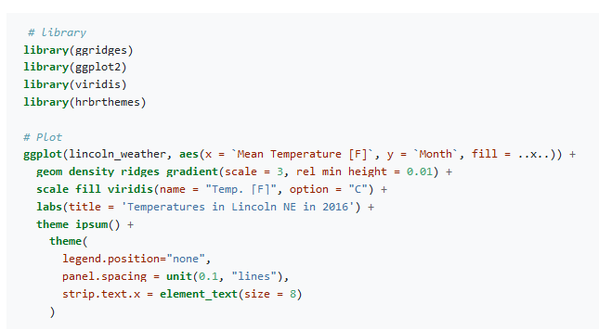
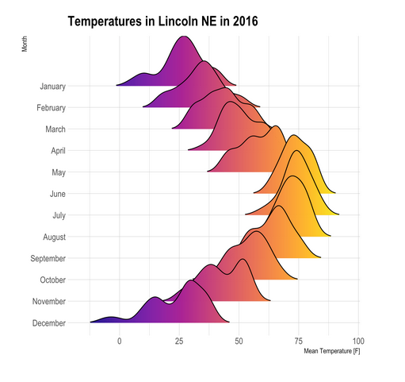
www.r-graph-gallery.com
https://www.r-graph-gallery.com/294-basic-ridgeline-plot.html#color

Slide 8
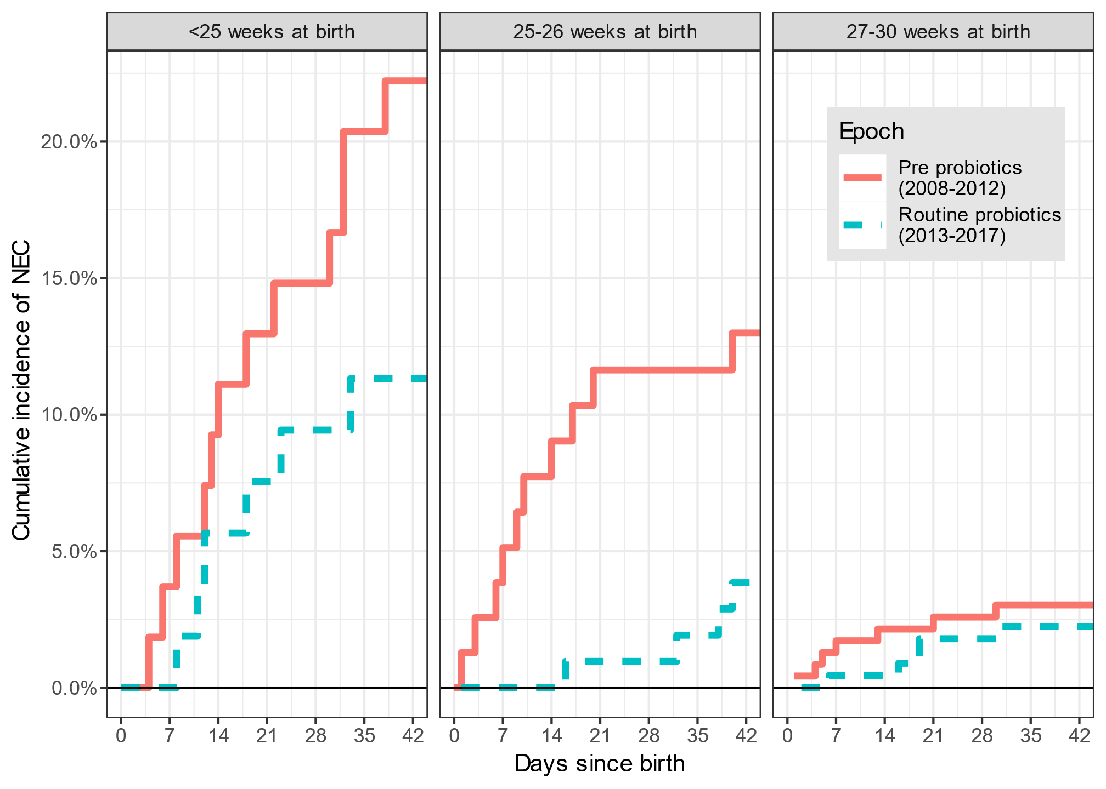
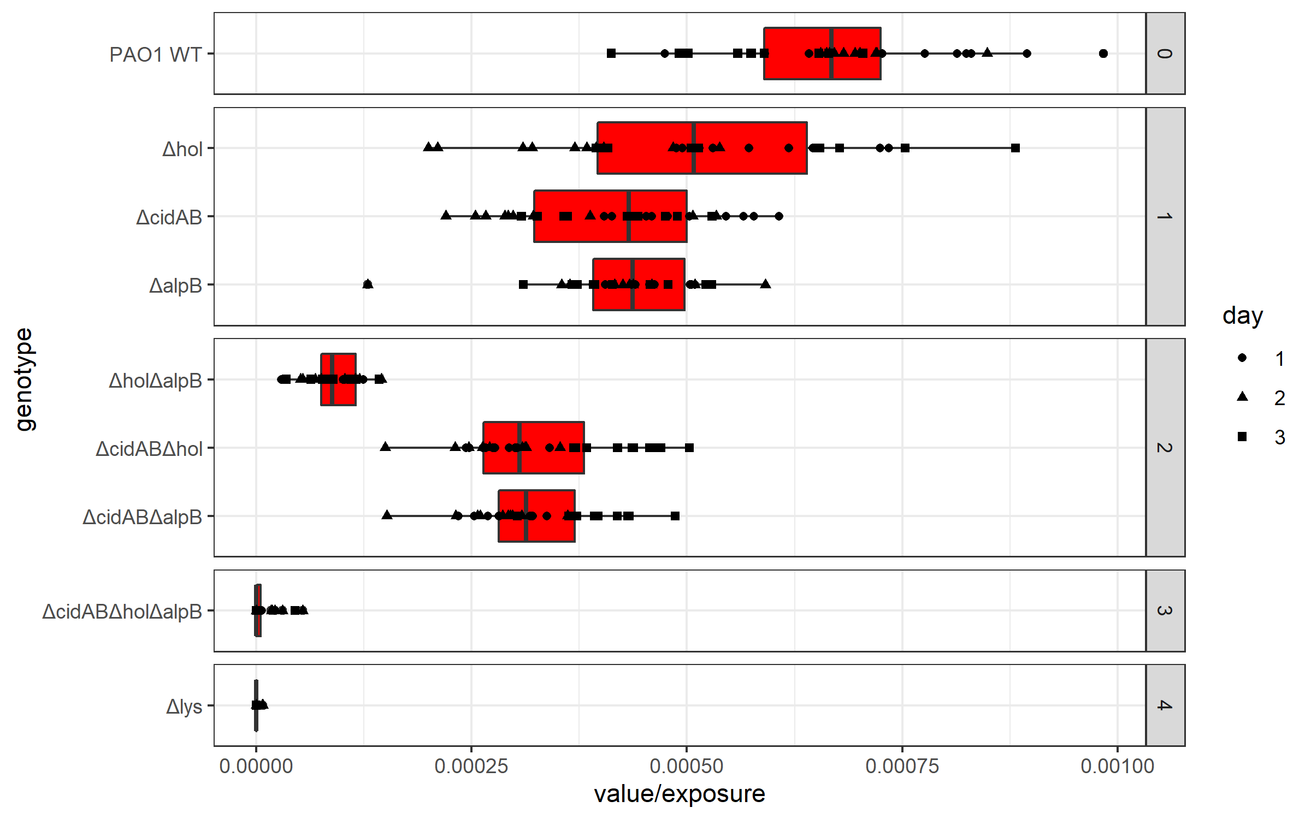
Some graphs I’ve made
Horizontal plots can be easier to read than vertical ones
Can use Unicode characters (here Greek)
Layering two kinds of plot
Facetting
Easy faceting and good control of legends
A cumulative incidence function from ‘survival’ package. *any* set of results can be graphed if we can make it into a dataframe

Slide 9
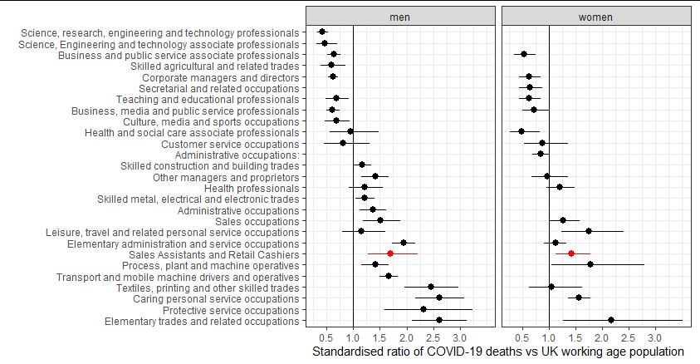
Dot plots / Confidence intervals

Slide 10
Some graphs I’ve made
Using ‘ggrepel’ labels will avoid points and each other

Slide 11
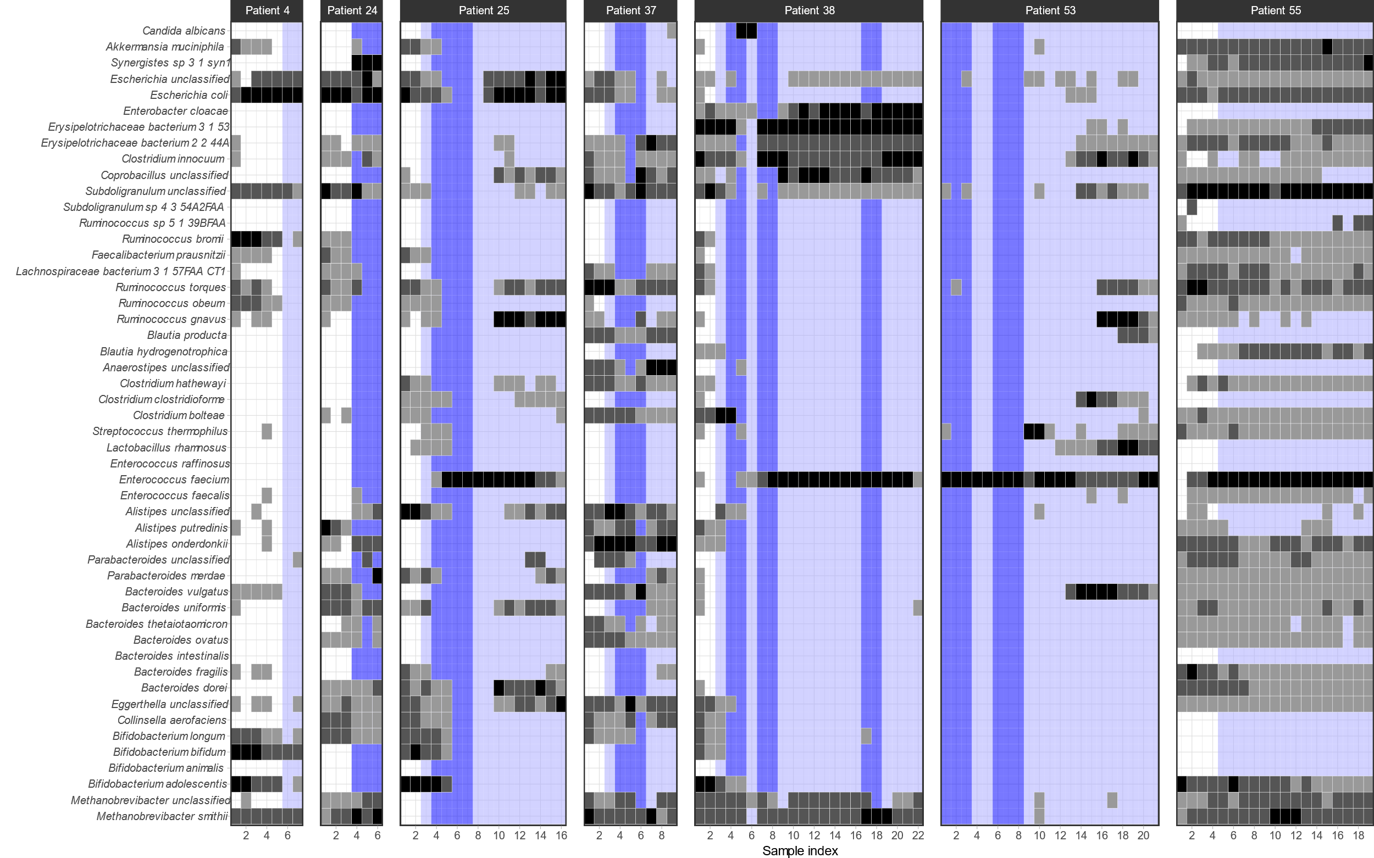
heatmaps

Slide 12
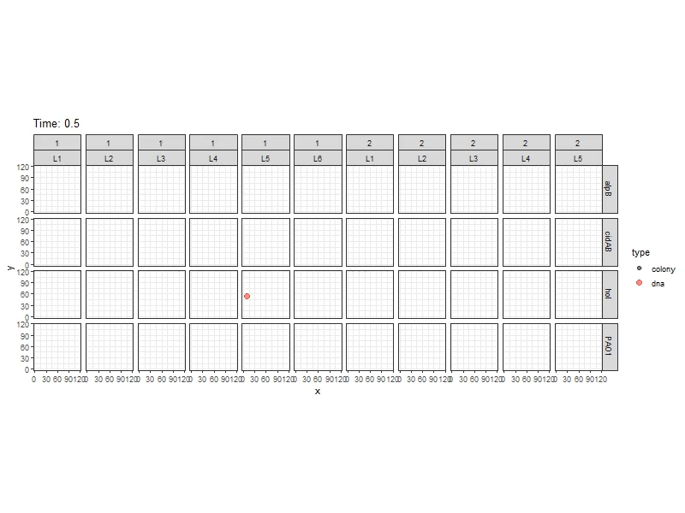
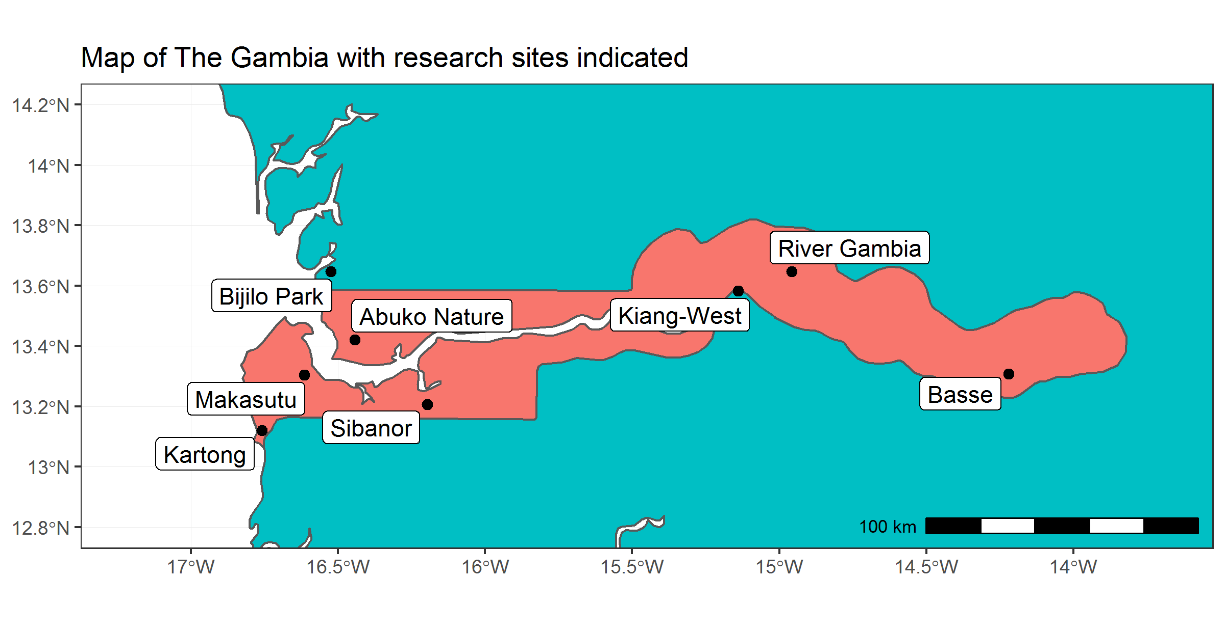
Packages for extending ggplot:
sf (maps)
gganimate (animation)
There are hundreds of these add on packages!

Slide 13
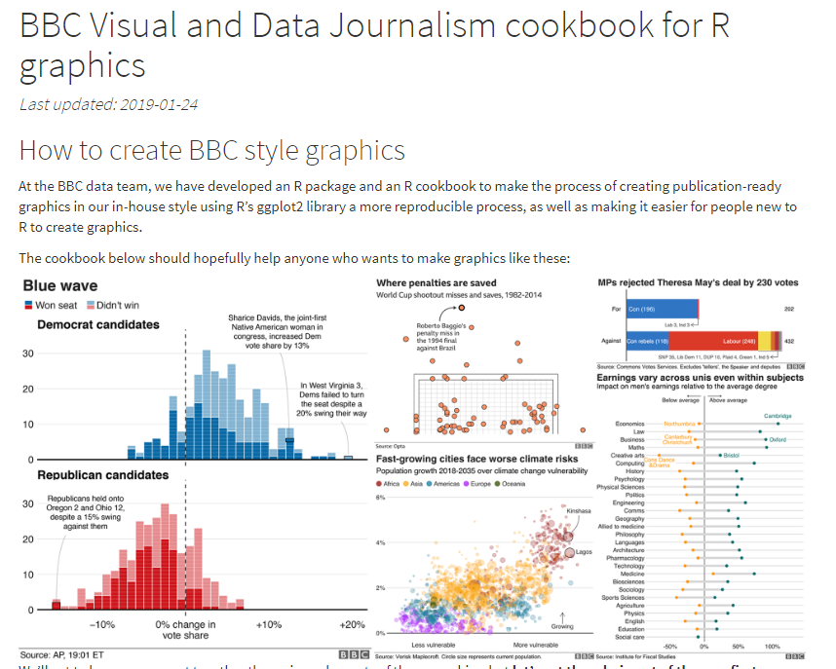
https://bbc.github.io/rcookbook/

Slide 14
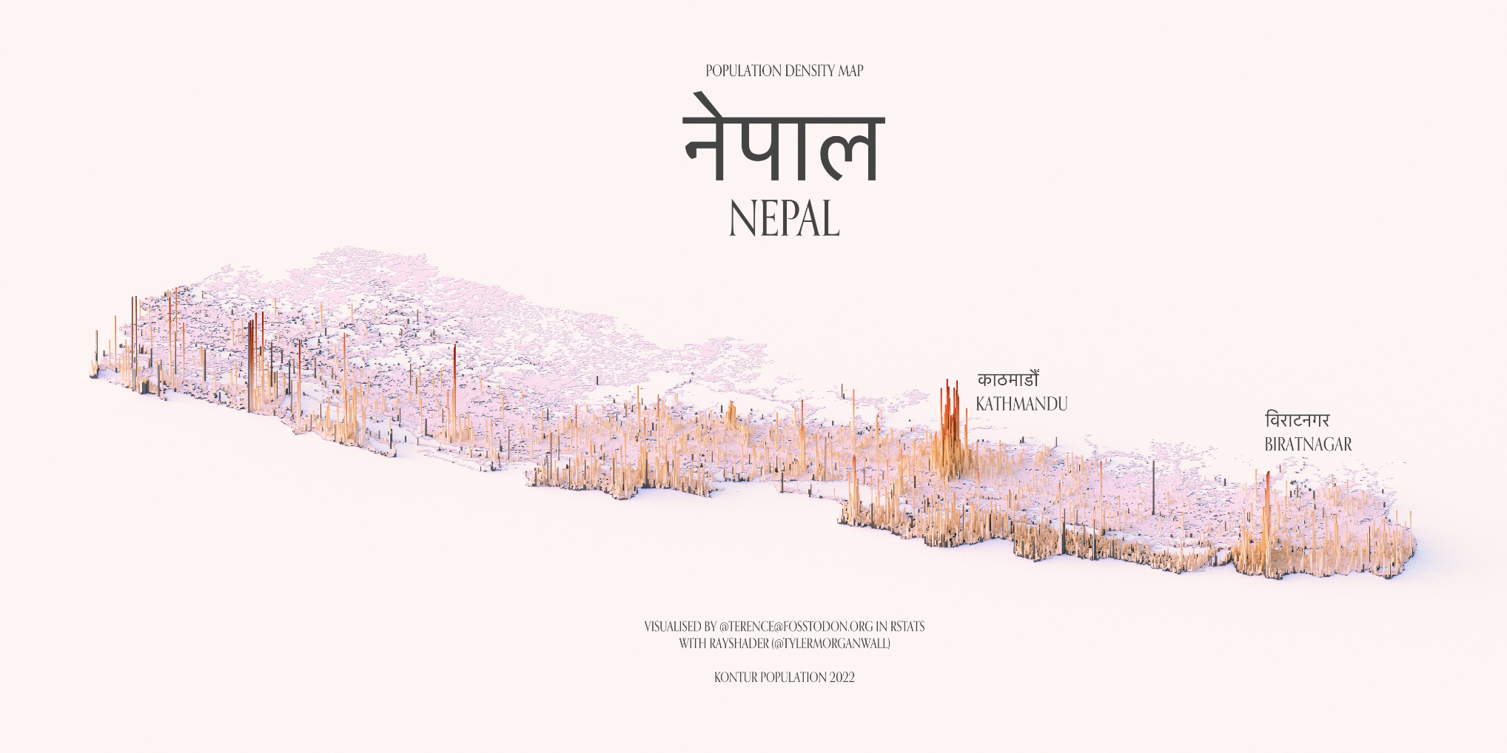
3D

Slide 15
The only limit is your imagination
Data coaster! https://www.tylermw.com/datacoaster-tycoon/

Slide 16
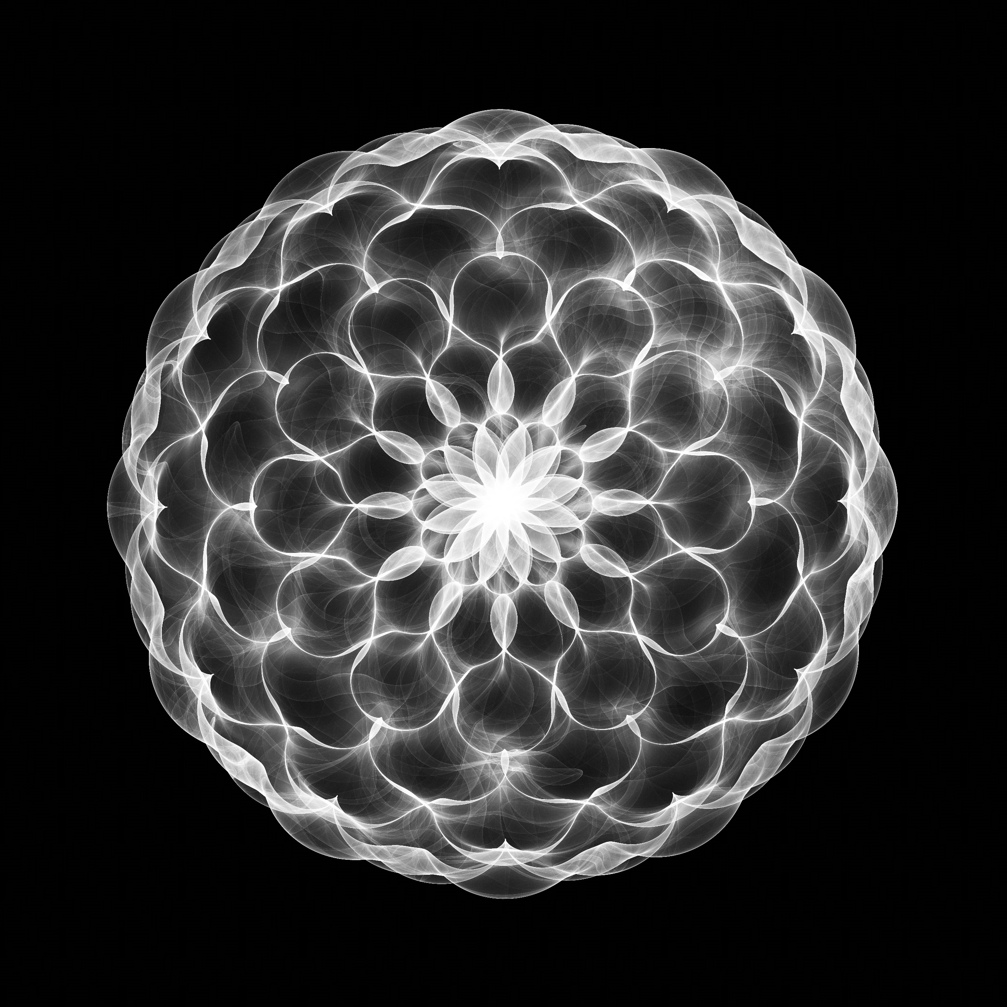
#rtistry

Slide 17
A simple example (do this)
ggplot(data = walkingdata) + aes(x=age, y=time) + geom_point()

Slide 18
Common grammar of graphics
How does ggplot2 work?
You describe the components of the graph you want in code
Using a ‘grammar of graphics’ that describes how your data should be presented.
ggplot2 implements this idea for R
(go to flipbook).

Slide 19
Aesthetic mapping
The central idea of ggplot is aesthetic mapping
Aesthetic mapping
Aesthetics
Data
sex
x
age
y
patid
color
treated
size
time
shape

Slide 20
Elements of ggplot2 grammar
Data – which data frame to use
Aesthetic mapping – how the variables in your data map onto the graph and graph objects
Geometric objects – what objects represent the data (box, line, point etc)
Scales – how should values be mapped and labelled
Facets – stratification of the graph
Statistics – eg means, counts or standard errors
Coordinates –the dimensions of the plot
Labels – how should the aesthetics be labelled
Theme – extra detail about the look

Slide 21
Step 1 - data
Choose the data frame that you want to use:
ggplot(alldata)
This won’t do anything useful by itself

Slide 22
Step 2 – aesthetic mapping
Aesthetic mapping:
How are the columns in your data represented on your graph
First decide which variables will be represented on the x and y axes:
ggplot(alldata, aes(x=treated, y=time))
What did it do?

Slide 23
Step 3 – add a ‘geom’
Add a geometric object:
ggplot(walkingdata, aes(x=treated, y=time)) + geom_point()
Note the ‘+’ used to ‘add’ gg objects. This is how we add elements together.

Slide 24
Aesthetic mapping
ggplot(walkingdata, aes(x=treated, y=time)) + geom_point()
Data
Aesthetics used by geom_point
sex
x
age
y
patid
color
treated
size
time
Aesthetic mapping
shape
ggplot(walkingdata) + geom_point(aes(x=treated, y=time))
ggplot(walkingdata) + aes(x=treated, y=time) + geom_point()

Slide 25
geoms that I use a lot
Geometric object | Use
geom_point | Points (scatter plot / dot plot)
geom_line | Lines
geom_boxplot / geom_violin | Box plots / Violin plots
geom_errorbar / geom_pointrange | Error bars
geom_bar / geom_histogram / geom_col | Histograms or bar graphs
geom_tile / geom_raster | Heatmaps
geom_text / geom_label | Text labels within the graph area
geom_beeswarm | ‘beeswarm’ graphs
geom_label_repel / geom_text_repel | Text and labels that ‘get out of the way’

Slide 26
Which aesthetics do they need or use?
Geometric object | Possible aesthetics. Needed = bold.
geom_point | x, y, alpha, color, fill, group, shape, size, stroke
geom_line / geom_path / geom_step | x, y, alpha, color, linetype, size, group
geom_boxplot | x, (y), lower, upper, middle, ymin, ymax, alpha, colour, fill, group, linetype, shape, size, weight
geom_errorbar / geom_pointrange | x, (y), ymin, ymax, size, linetype, colour, width, alpha
geom_histogram / geom_bar | x, y, alpha color, fill, group, linetype, size
geom_tile / geom_raster | x, y, alpha, color, fill, group, height, linetype, size, width
geom_text / geom_label | x, y, label, alpha, colour, fill, group, shape, size, stroke
geom_beeswarm | same as geom_point
geom_label_repel / geom_text_repel | same as geom_text

Slide 27
Step 4 – Change the scale
Scales define how the variable is mapped to the geom
ggplot(alldata, aes(x=treated, y=time)) + geom_point() + scale_y_log10()
Scales are also how we define specific colour mappings and shapes:
ggplot(alldata, aes(x=treated, y=time, color=treated)) + geom_point() + scale_y_log10() + scale_color_manual(values=c(“treated”=“red”, “control”=“black”))
Note how I’ve split the command over lines to make it easier to read.
You must leave the + or , at the end of each line, (or otherwise indicate the command isn’t finished).

Slide 28
Exercises
Load the walking speed data
Exercise 1
Make a scatter plot of time vs age
Change this plot to make the color of each point reflect the treatment
Make a regression line
Exercise 2
Make a box plot of time by sex, with a different coloured box per sex
Label the axes appropriately
Add the individual points back on top of the boxplot using a points (or beeswarms, for which you’ll need to install the ggbeeswarm package)

Slide 29
4 - Scales
Scale functions describe how the values in the data map to the aesthetic
For example:
Setting breaks for axis aesthetics:
scale_x_continuous(breaks=c(1,2,3,4,5))
Changing the scale to logarithmic:
scale_y_log10()
Picking more visually appealing colours for continuous or discrete scales:
scale_color_brewer() # There are hundreds of available colour palettes.
scale_fill_manual(values=c(“red”,”blue”,”green”))

Slide 30
5 – Facets
Stratify the plot using variables in your dataset
facet_wrap() is easier to use
facet_grid() gives you more control in two dimensions
ggplot(alldata, aes(x=treated, y=time)) + geom_boxplot() + scale_y_log10() + facet_wrap(~sex)

Slide 31
6 - Summary statistics
As well as the raw data we can add summaries.
Add (for example) means and standard error.
+ stat_summary( geom=“bar”, fun.y=mean ) +
stat_summary( geom=“errorbar”, fun.data=mean_se )
A scatter plot can take stat_smooth() to add a lowess or regression line.

Slide 32
Adding p-values (try to avoid this)
The ‘ggpubr’ library can add p-values to a plot:
install.packages("ggpubr")
library(ggpubr)
ggplot(alldata2, aes(x=treated, y=speed, fill=treated)) + geom_boxplot() + facet_wrap(~sex) + scale_fill_manual(values=c("red","green")) + stat_compare_means(method="t.test", comparisons = list(c("Control","Treat")))

Slide 33
8. Labels
Next, we’ll fix the labels:
ggplot(alldata2, aes(x=treated, y=speed, fill=treated)) + geom_boxplot() + geom_beeswarm() + facet_wrap(~sex, labeller=labeller(sex=c("Male", "Female")) + scale_fill_manual(values=c("red","green")) + stat_compare_means(method="t.test", comparisons = list(c("Control","Treat"))) + labs(x="Treatment", y="Walking speed (m/s) ", fill="Treatment")
# Notice that to assign variable labels, labs() labels the aesthetics (x, y, fill), not the variables themselves!
# On the other hand ‘labellers’ assigns value labels to variables

Slide 34
9. Themes…and done!
Control the overall look. I almost always use theme_bw() for publication graphs
Control individual elements with theme()
ggplot(alldata, aes(x=treated, y=time, fill=treated)) +
geom_boxplot() +
geom_beeswarm(cex=3) +
facet_wrap(~sex, labeller=labeller(sex=c(M="Male",F="Female"))) +
scale_fill_manual(values=c("red","green")) +
scale_y_log10() +
stat_compare_means(method="t.test", comparisons = list(c("Control","Treat"))) +
labs(x="Treatment", y="Walking speed (m/s) ", fill="Treatment") +
theme(legend.position = "none") + theme_bw()

Slide 35
A similar graph with ‘base’ graphics
This is possible but the code is much messier.
par(mfrow=c(1,2))
boxplot(data=subset(alldata2, sex=="M"), speed ~ treated, col=c("red","green"), main="Male")
beeswarm(speed ~ treated, data = subset(alldata2, sex=="M"), add = TRUE, col = 'black', pch=20)
boxplot(data=subset(alldata2, sex=="F"), speed ~ treated, col=c("red","green"), main="Female")
beeswarm(speed ~ treated, data = subset(alldata2, sex=="F"), add = TRUE, col = 'black', pch=20)

Slide 36
Saving ggplot2 graphs
Options for including ggplot2 graphics in documents:
Incorporate in Quarto document
Manually export from Rstudio (zoom, then copy/save)
ggsave() function
You can choose the size, scale, image format and resolution.
Use vector graphics (svg) or high resolution ratser (png with dpi=“retina”).
Getting the size/scale right can be trial and error.

Slide 37
Thank you
This has been a very brief overview
Basics of R and Rstudio
Loading data from Excel
Tidy data
Simple tests
Linear models
Graphing
Signposting to resources
I hope you finish the handouts
Remember – contact me if needed and continue to read and learn
Support each other
Please complete feedback forms or let me know what you think directly

